Slide 1
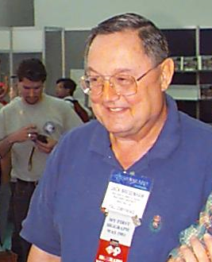
The Bresenham Line Algorithm
The Bresenham Algorithm is another incremental scan conversion algorithm
The big advantage of this algorithm is that it uses only integer calculations
Jack Bresenham worked for 27 years at IBM before entering academia. Bresenham developed his famous algorithms at IBM in the early 1960s

Slide 2
The Bresenham Line Algorithm
Move across the x axis in unit intervals and at each step choose between two different y coordinates
For example, from position (2,3) we have to choose between (3,3) and (3,4)
We would like the point that is closer to the original line
5
(x_{k}+1, y_{k}+1)
4
(x_{k}, y_{k})
3
(x_{k}+1, y_{k})
2
2
3
4
5

Slide 3
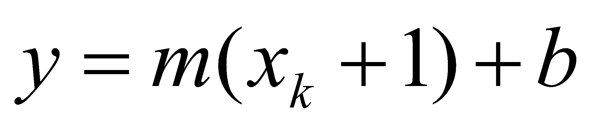
Deriving The Bresenham Line Algorithm
At sample position x_{k}+1 the vertical separations from the mathematical line are labelled d_{upper} and d_{lower}
y_{k+1}
d_{upper}
y
d_{lower}
y_{k}
x_{k}+1
The y coordinate on the mathematical line at x_{k}+1 is:

Slide 4
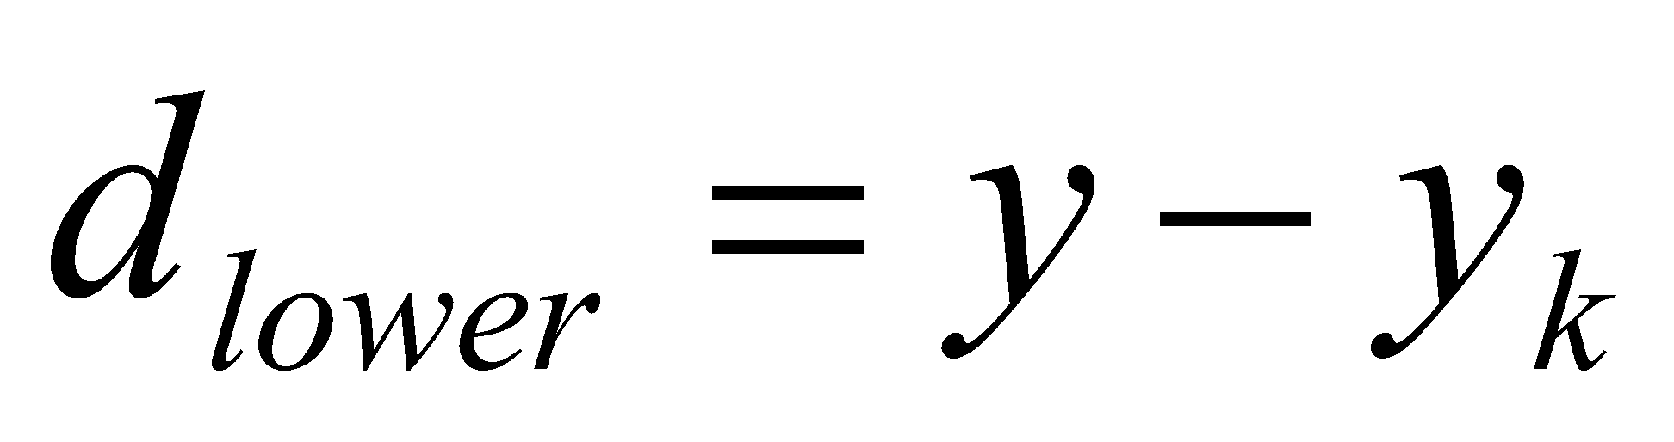
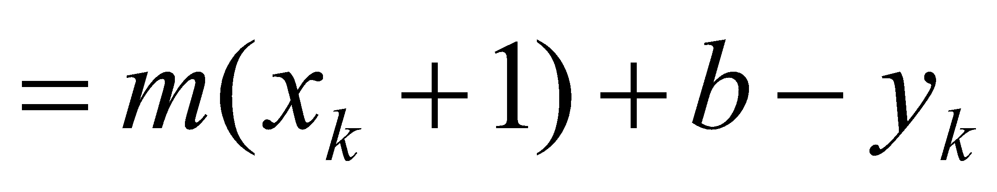
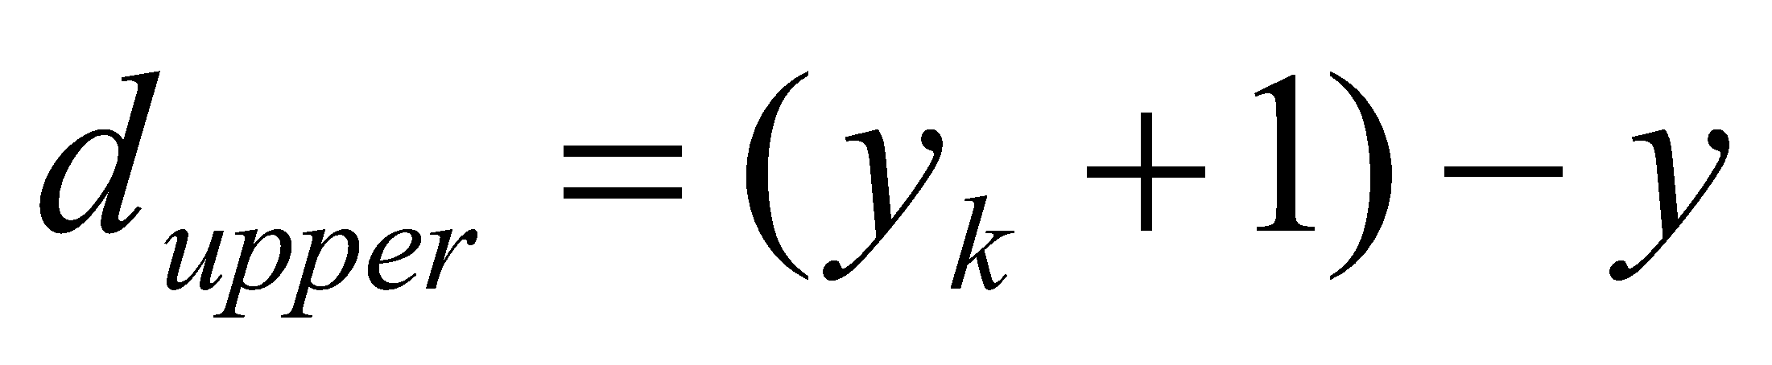
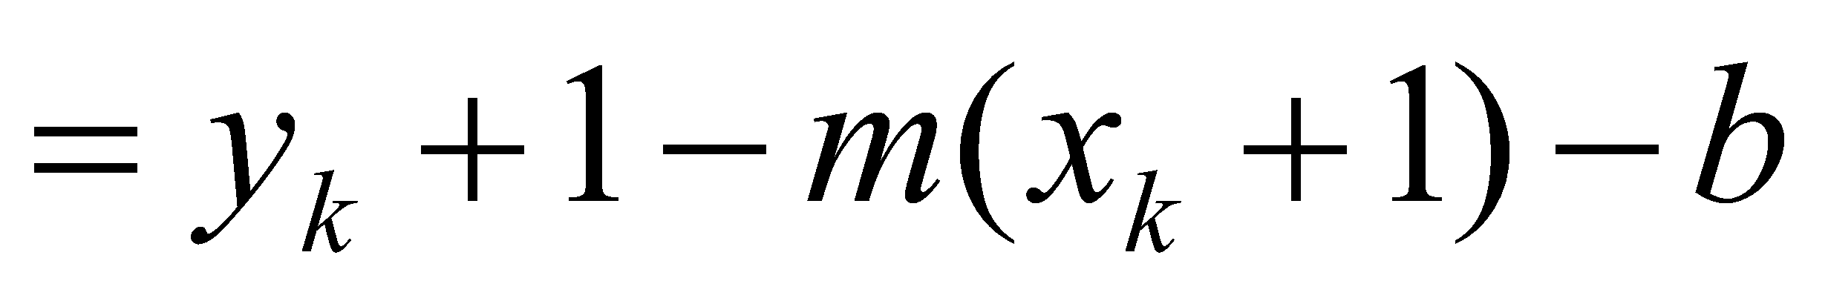
Deriving The Bresenham Line Algorithm (cont…)
So, d_{upper} and d_{lower} are given as follows:
and:
We can use these to make a simple decision about which pixel is closer to the mathematical line

Slide 5
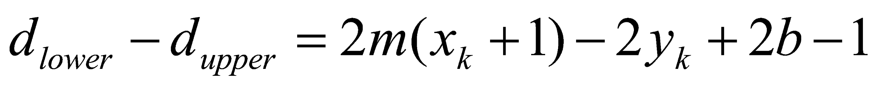
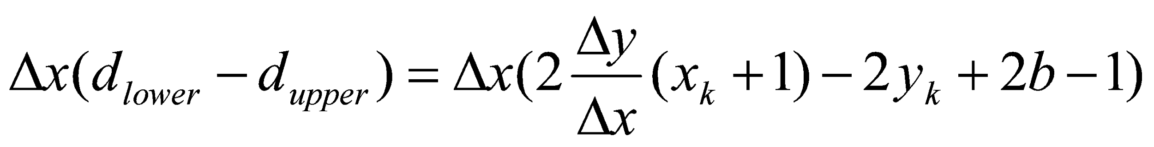
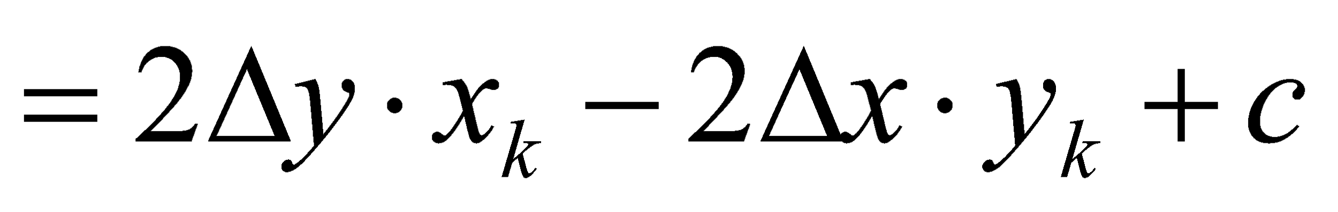
Deriving The Bresenham Line Algorithm (cont…)
This simple decision is based on the difference between the two pixel positions:
Let’s substitute m with ∆y/∆x where ∆x and ∆y are the differences between the end-points:

Slide 6
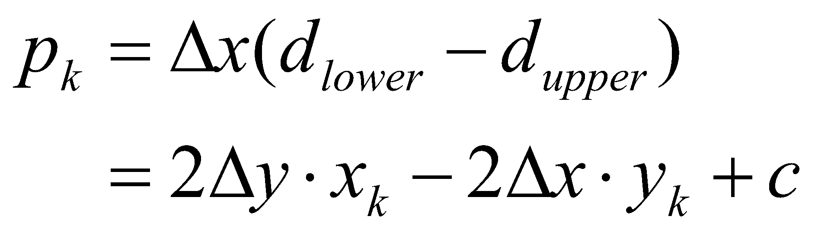
Deriving The Bresenham Line Algorithm (cont…)
So, a decision parameter p_{k} for the kth step along a line is given by:
The sign of the decision parameter p_{k} is the same as that of d_{lower} – d_{upper}
If p_{k} is negative, then we choose the lower pixel, otherwise we choose the upper pixel

Slide 7
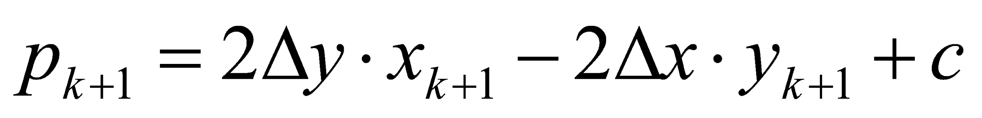
Deriving The Bresenham Line Algorithm (cont…)
Remember coordinate changes occur along the x axis in unit steps so we can do everything with integer calculations
At step k+1 the decision parameter is given as:
Subtracting p_{k} from this we get:

Slide 8
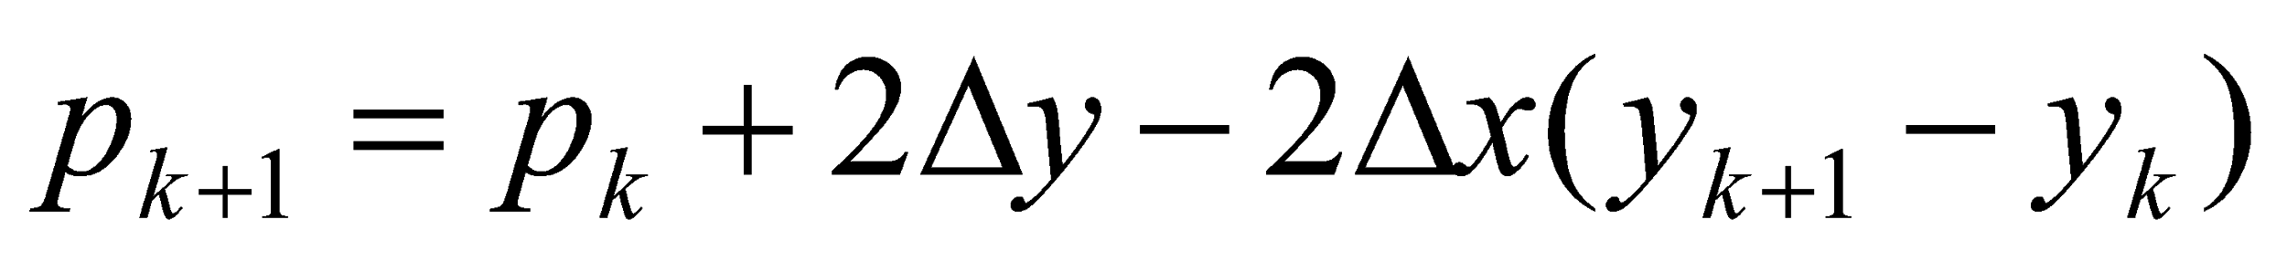
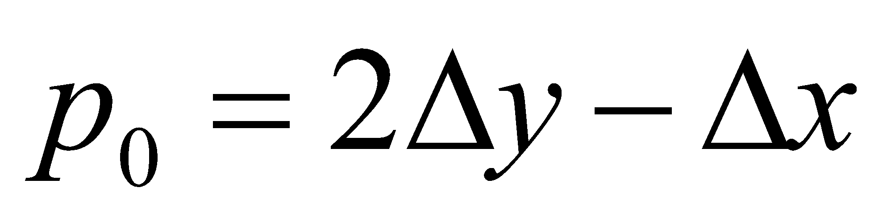
Deriving The Bresenham Line Algorithm (cont…)
But, x_{k+1} is the same as x_{k}+1 so:
where y_{k+1} - y_{k} is either 0 or 1 depending on the sign of p_{k}
The first decision parameter p0 is evaluated at (x0, y0) is given as:

Slide 9
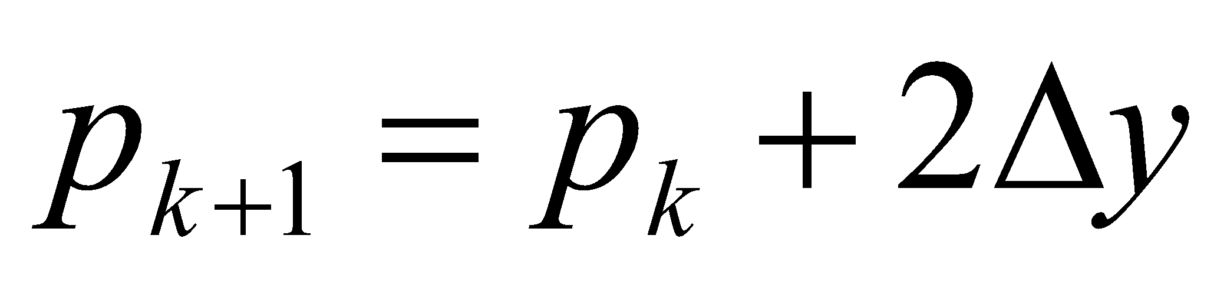
The Bresenham Line Algorithm
BRESENHAM’S LINE DRAWING ALGORITHM (for |m| < 1.0)
Input the two line end-points, storing the left end-point in (x₀, y₀)
Plot the point (x₀, y₀)
Calculate the constants Δx, Δy, 2Δy, and (2Δy - 2Δx) and get the first value for the decision parameter as:
At each x_{k} along the line, starting at k = 0, perform the following test. If p_{k} < 0, the next point to plot is (x_{k}+1, y_{k}) and:

Slide 10
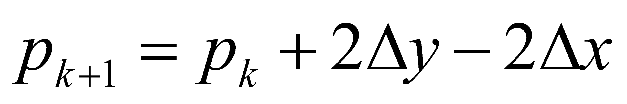
The Bresenham Line Algorithm (cont…)
Otherwise, the next point to plot is (x_{k}+1, y_{k}+1) and:
Repeat step 4 (Δx – 1) times
The algorithm and derivation above assumes slopes are less than 1. for other slopes we need to adjust the algorithm slightly

Slide 11
Bresenham Example
Let’s have a go at this
Let’s plot the line from (20, 10) to (30, 18)
First off calculate all of the constants:
Δx: 10
Δy: 8
2Δy: 16
2Δy - 2Δx: -4
Calculate the initial decision parameter p₀:
p0 = 2Δy – Δx = 6

Slide 12
Bresenham Example (cont…)
k | p_{k} | (x_{k+1},y_{k+1})
0 1 2 3 4 5 6 7 8 9
18
17
16
15
14
13
12
11
10
20
21
22
23
24
25
26
27
28
29
30

Slide 13
Bresenham Exercise
Go through the steps of the Bresenham line drawing algorithm for a line going from (21,12) to (29,16)

Slide 14
Bresenham Exercise (cont…)
k | p_{k} | (x_{k+1},y_{k+1})
0 1 2 3 4 5 6 7 8
18
17
16
15
14
13
12
11
10
20
21
22
23
24
25
26
27
28
29
30

Slide 15
Bresenham Line Algorithm Summary
The Bresenham line algorithm has the following advantages:
An fast incremental algorithm
Uses only integer calculations
Comparing this to the DDA algorithm, DDA has the following problems:
Accumulation of round-off errors can make the pixelated line drift away from what was intended
The rounding operations and floating point arithmetic involved are time consuming

Slide 16
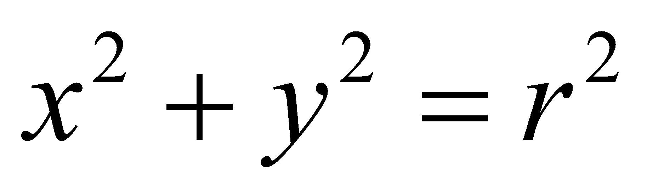
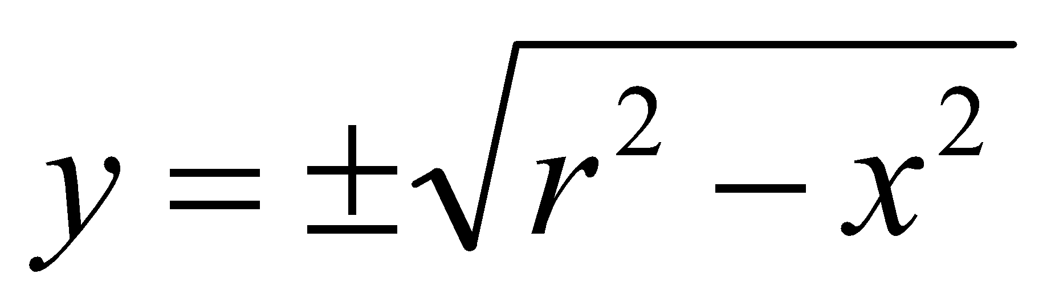
A Simple Circle Drawing Algorithm
The equation for a circle is:
where r is the radius of the circle
So, we can write a simple circle drawing algorithm by solving the equation for y at unit x intervals using:

Slide 17
A Simple Circle Drawing Algorithm (cont…)
However, unsurprisingly this is not a brilliant solution!
Firstly, the resulting circle has large gaps where the slope approaches the vertical
Secondly, the calculations are not very efficient
The square (multiply) operations
The square root operation – try really hard to avoid these!
We need a more efficient, more accurate solution

Slide 18
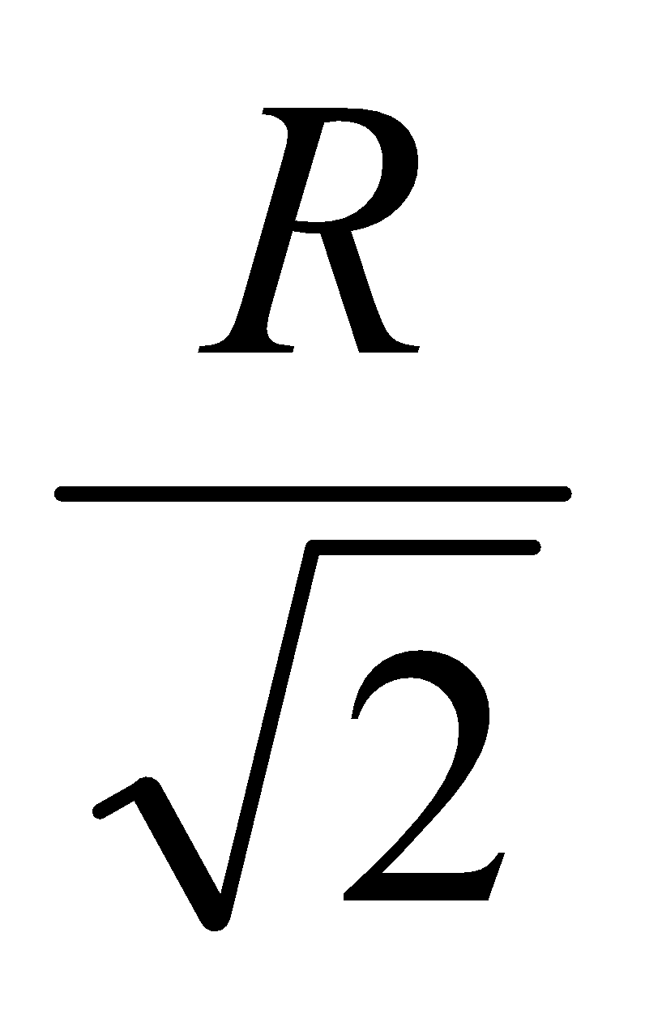
Eight-Way Symmetry
The first thing we can notice to make our circle drawing algorithm more efficient is that circles centred at (0, 0) have eight-way symmetry
(-x, y)
(x, y)
(-y, x)
(y, x)
(-y, -x)
(y, -x)
(-x, -y)
(x, -y)

Slide 19
Mid-Point Circle Algorithm
Similarly to the case with lines, there is an incremental algorithm for drawing circles – the mid-point circle algorithm
In the mid-point circle algorithm we use eight-way symmetry so only ever calculate the points for the top right eighth of a circle, and then use symmetry to get the rest of the points

Slide 20
Mid-Point Circle Algorithm (cont…)
Assume that we have just plotted point (x_{k}, y_{k})
The next point is a choice between (x_{k}+1, y_{k}) and (x_{k}+1, y_{k}-1)
We would like to choose the point that is nearest to the actual circle
So how do we make this choice?
(x_{k}, y_{k})
(x_{k}+1, y_{k})
(x_{k}+1, y_{k}-1)

Slide 21
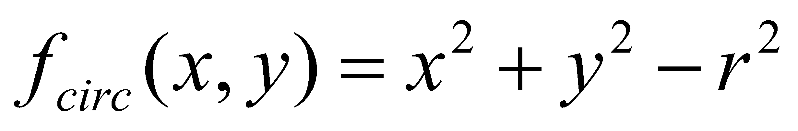
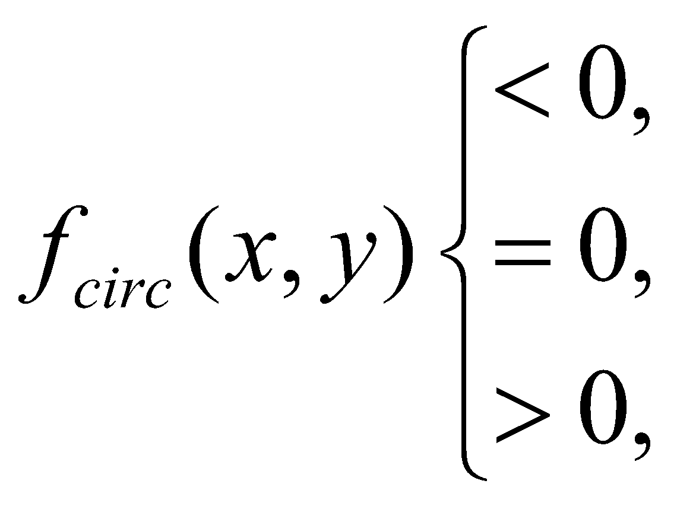
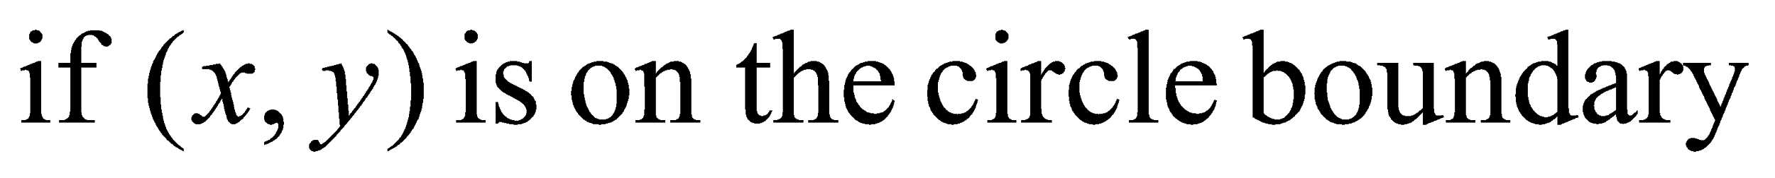
Mid-Point Circle Algorithm (cont…)
Let’s re-jig the equation of the circle slightly to give us:
The equation evaluates as follows:
By evaluating this function at the midpoint between the candidate pixels we can make our decision

Slide 22
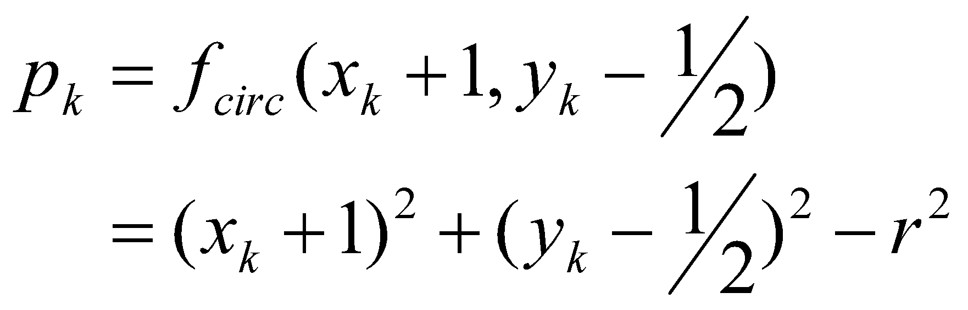
Mid-Point Circle Algorithm (cont…)
Assuming we have just plotted the pixel at (x_{k},y_{k}) so we need to choose between (x_{k}+1,y_{k}) and (x_{k}+1,y_{k}-1)
Our decision variable can be defined as:
If p_{k} < 0 the midpoint is inside the circle and and the pixel at y_{k} is closer to the circle
Otherwise the midpoint is outside and y_{k}-1 is closer

Slide 23
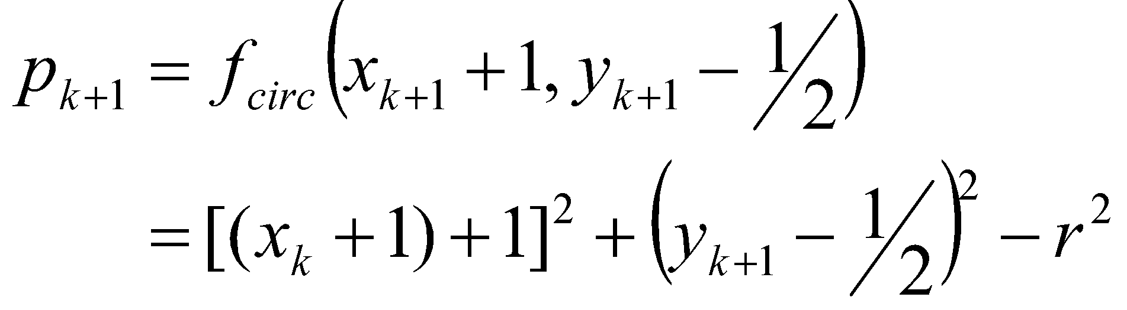
Mid-Point Circle Algorithm (cont…)
To ensure things are as efficient as possible we can do all of our calculations incrementally
First consider:
or:
where y_{k+1} is either y_{k} or y_{k}-1 depending on the sign of p_{k}

Slide 24
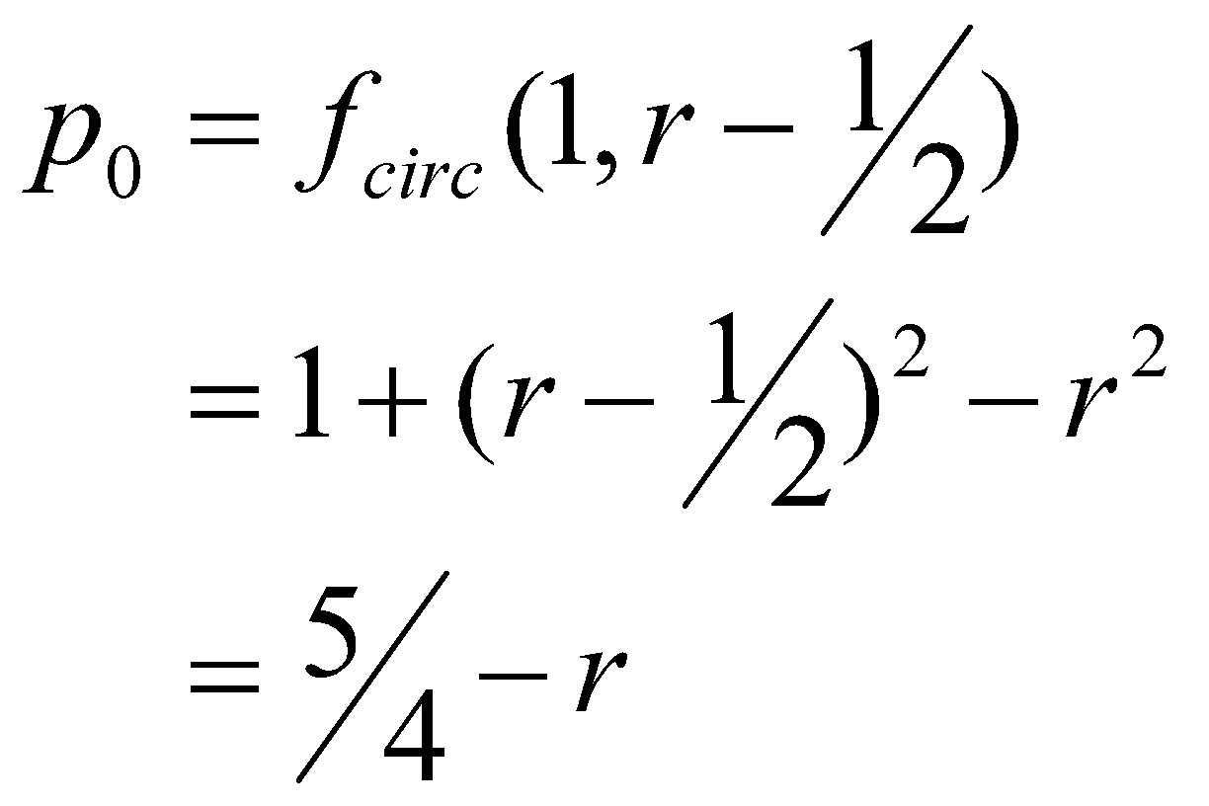
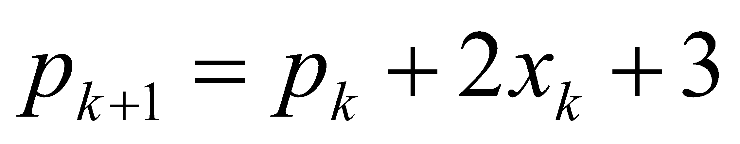
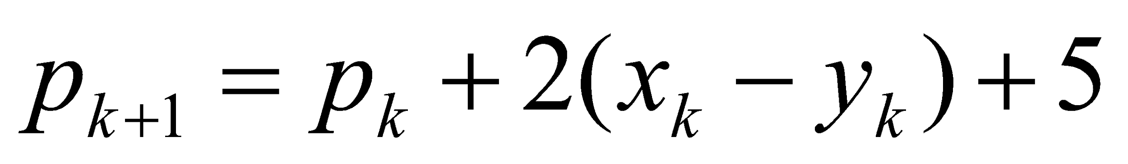
Mid-Point Circle Algorithm (cont…)
The first decision variable is given as:
Then if p_{k} < 0 then the next decision variable is given as:
If p_{k} > 0 then the decision variable is:

Slide 25
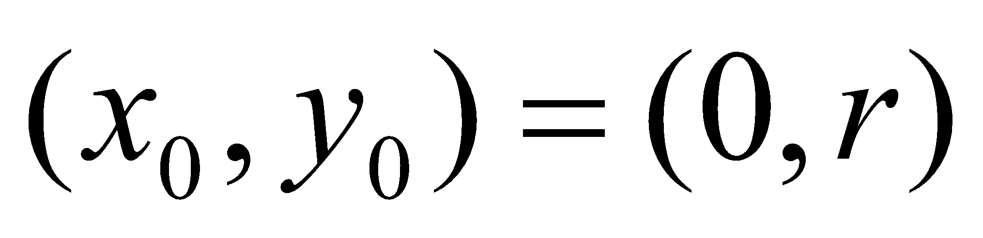
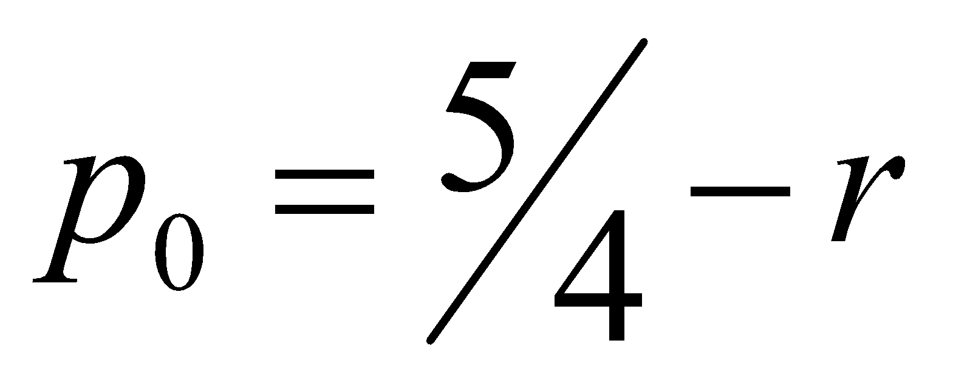
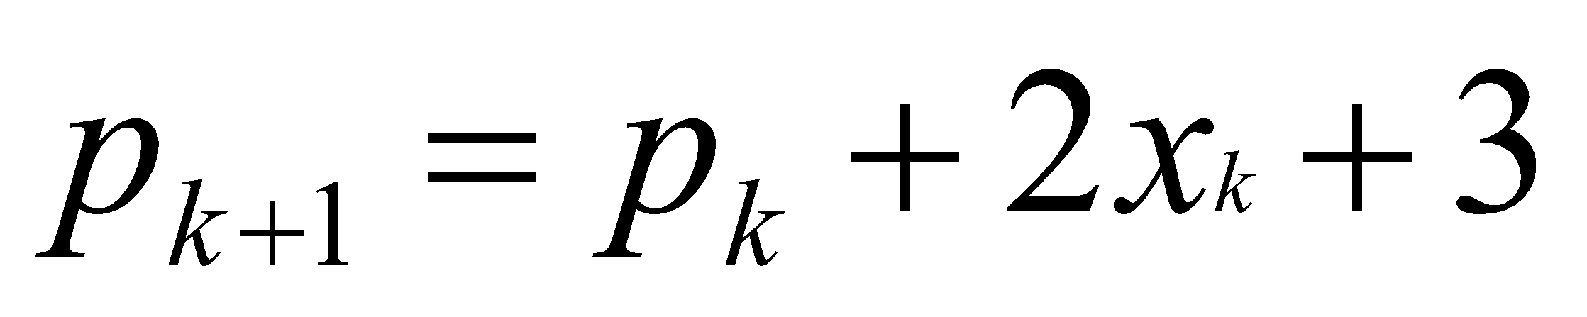
The Mid-Point Circle Algorithm
MID-POINT CIRCLE ALGORITHM
Input radius r and circle centre (x_{c}, y_{c}), then set the coordinates for the first point on the circumference of a circle centred on the origin as:
Calculate the initial value of the decision parameter as:
Starting with k = 0 at each position x_{k}, perform the following test. If p_{k} < 0, the next point along the circle centred on (0, 0) is (x_{k}+1, y_{k}) and:

Slide 26
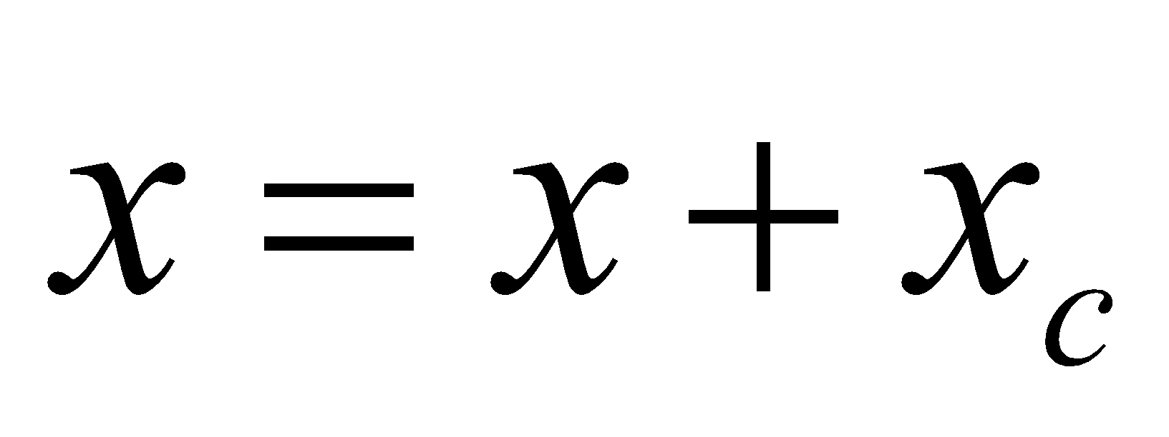
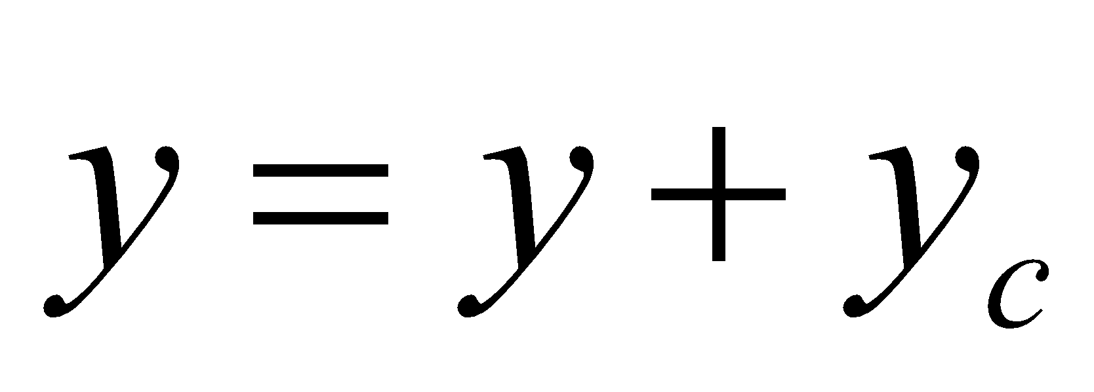
The Mid-Point Circle Algorithm (cont…)
Otherwise the next point along the circle is (x_{k}+1, y_{k}-1) and:
Determine symmetry points in the other seven octants
Move each calculated pixel position (x, y) onto the circular path centred at (x_{c}, y_{c}) to plot the coordinate values:
Repeat steps 3 to 5 until x >= y

Slide 27
Mid-Point Circle Algorithm Example
To see the mid-point circle algorithm in action lets use it to draw a circle centred at (0,0) with radius 10

Slide 28
Mid-Point Circle Algorithm Example (cont…)
10
k | p_{k} | (x_{k+1},y_{k+1}) | 2x_{k+1} | 2y_{k+1}
0 1 2 3 4 5 6
9
8
7
6
5
4
3
2
1
0
0
1
2
3
4
5
6
7
8
9
10

Slide 29
Mid-Point Circle Algorithm Exercise
Use the mid-point circle algorithm to draw the circle centred at (0,0) with radius 15

Slide 30
Mid-Point Circle Algorithm Example (cont…)
16
k | p_{k} | (x_{k+1},y_{k+1}) | 2x_{k+1} | 2y_{k+1}
0 1 2 3 4 5 6 7 8 9 10 11 12
15
14
13
12
11
10
9
8
7
6
5
4
3
2
1
0
0
1
2
3
4
5
6
7
8
9
10
11
12
13
14
15
16

Slide 31
Mid-Point Circle Algorithm Summary
The key insights in the mid-point circle algorithm are:
Eight-way symmetry can hugely reduce the work in drawing a circle
Moving in unit steps along the x axis at each point along the circle’s edge we need to choose between two possible y coordinates

